Slide 1

Hybrid Kelly Criterion Trading Strategy
By: Leo Navarro

Slide 2
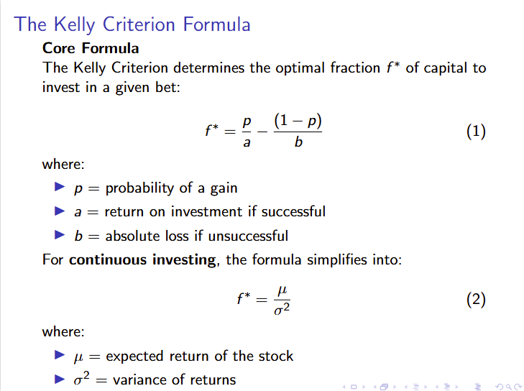
Introduction
Problem: Traditional portfolio trading strategies have suboptimal resource allocation: either under-utilize or over-leverage capital (ex. buy & hold)
Idea: Utilize the Kelly Criterion to create a trading strategy that dynamically adjusts positions sizes based on market conditions
Notes:
we want the name boiler quant to mean something. if anyone in this room places, it is a win for all of purdue. so while we have high expectations for you all, as an exec board we are holding ourselves to the same high standards to ensure you have the best chance to get to wherever it is you want to go.

Slide 3
Implementation
Market Regime Tracking
Trending Market: Short MA > Long MA (kelly multiplier > 1)
Mean Reversion Market: Short MA < Long MA (kelly multiplier < 1)
Hyperparameters determined through validation test (MAs, multipliers, etc)
Stock Selection
Randomly sampled high-growth stock list
Ran 25 trials to reduce selection bias
Took aggregate
Comparison
Benchmarked against a Buy & Hold strategy
Measured risk adjusted metrics: Sharpe Ratio & CAGR
Notes:
we want the name boiler quant to mean something. if anyone in this room places, it is a win for all of purdue. so while we have high expectations for you all, as an exec board we are holding ourselves to the same high standards to ensure you have the best chance to get to wherever it is you want to go.

Slide 4
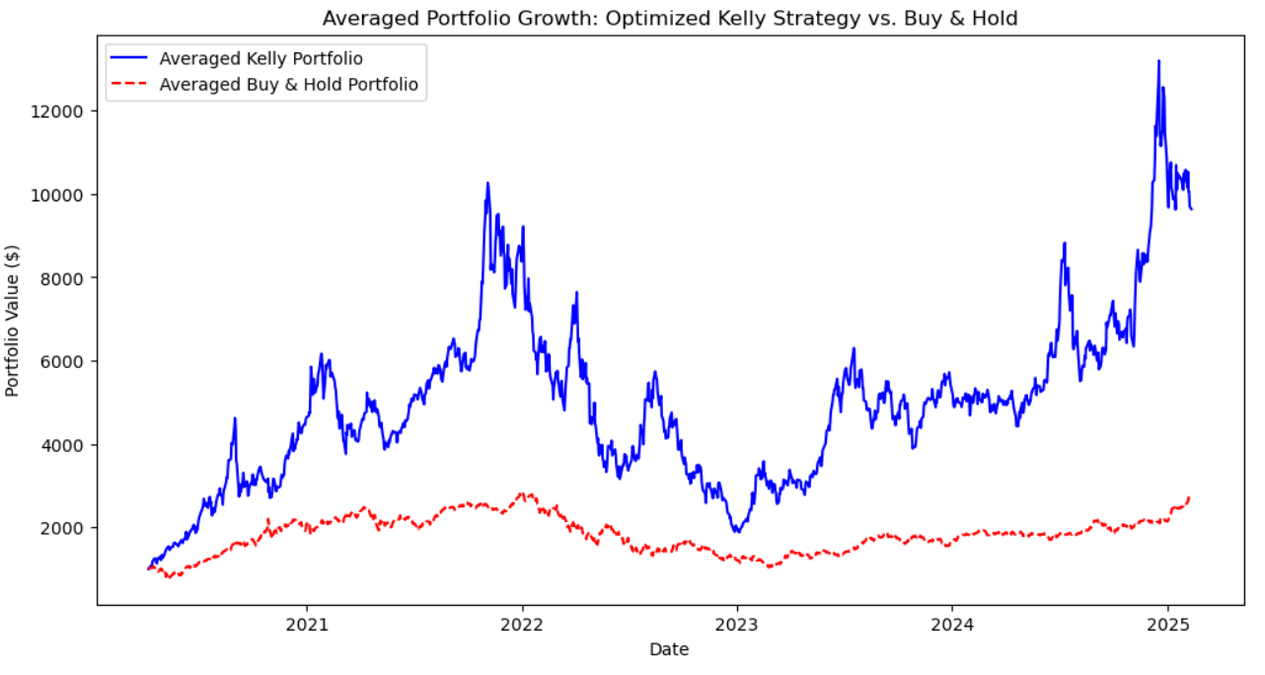
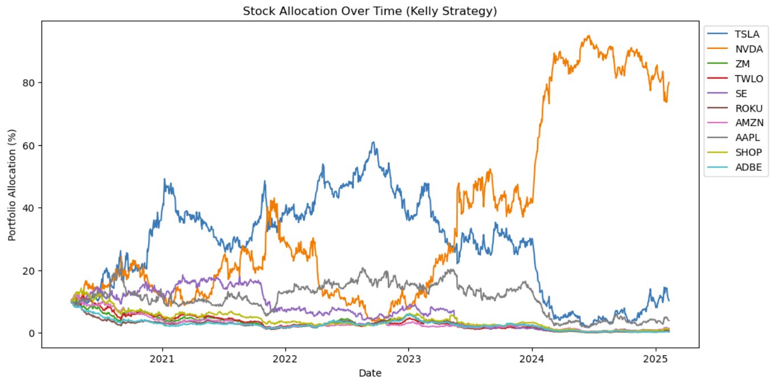
Results
Hybrid Kelly
5-year growth multiplier: 10.41x
Sharpe Ratio: 0.064
CAGR: 59.54%
Buy & Hold
5-year growth multiplier: 2.99x
Sharpe Ratio: 0.047
CAGR: 23.72%
Issues and Solutions
Lack of diversification over time
Solution: Can “reset” the process when a stock exceeds X% of portfolio
Liquidity Constraints & Trading Costs
Solution: Focus on high-liquidity stocks with deep order books and tight bid-ask spreads
Final Takeaway: While the Hybrid Kelly Strategy significantly enhances returns, its effectiveness depends on active rebalancing and proper risk controls.
Notes:
we want the name boiler quant to mean something. if anyone in this room places, it is a win for all of purdue. so while we have high expectations for you all, as an exec board we are holding ourselves to the same high standards to ensure you have the best chance to get to wherever it is you want to go.

